Slide 1
KO in ethnic-racial studies
Nina Gomes Sobral Barcellos D’Almeida
Linair Maria Campos

Slide 2
Ethnic-racial studies
The field of ethnic-racial studies develops mainly from interdisciplinary efforts
Involving areas of knowledge such as history, geography, pedagogy, linguistics, anthropology, and different areas of healthcare
The subjects, items and concepts used may not be well represented in disciplinary classification systems, causing problems such as underrepresentation, omissions, or allocation in inappropriate classes

Slide 3
Representing ethnic-racial knowledge
Our goal: to systematize a theoretical-methodological path for the representation of knowledge within the scope of ethnic-racial studies, without occurring a prevalence of one perspective in relation to the others.
To validate our results: analyze the extent to which the ILC is an appropriate instrument for the representation of ethnic-racial knowledge, given the principles that are established as necessary for this representation.
Methodology: this research can be classified as qualitative, exploratory, developed through bibliographical and applied research (Gil, 2002)

Slide 4
ILC - Representing ethnic-racial knowledge
The ILC is developed based on the facet method and the integrative levels theory, representing as main classes phenomena instead of disciplines (Gnoli, 2012)
Represent the connection between areas of knowledge, theoretical perspectives and objects of knowledge
Also represent knowledge in a more inclusive way, where all communities involved can coexist in the classification scheme used

Slide 5
Dewey Classification
305.8 is common for ethnic-racial, related to Social Science issues
But the notion of ethnic groups is present in other CDD classes such as:
370.89 ethnic groups in education
270.089 ethnic-religious-Christianity group
364.089 racism – criminology
200.89 ethnic-religious groups

Slide 6
Bliss Classification

Slide 7
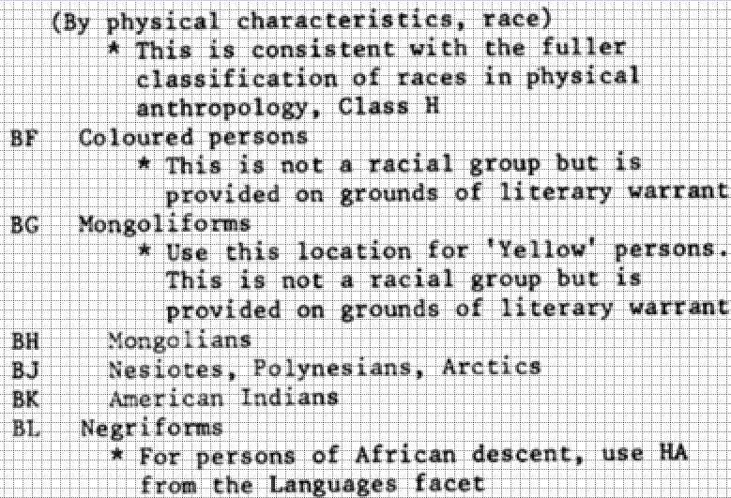
Bliss Classification
The notion of ethnic-racial groups appears related to physical characteristics or language

Slide 8
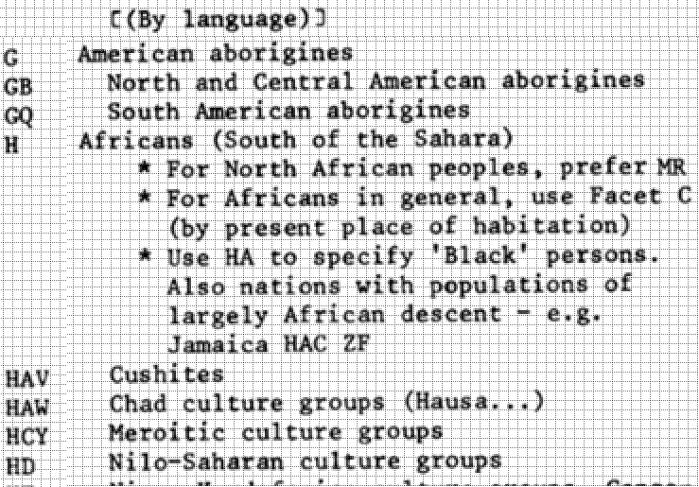
Bliss Classification
The notion of ethnic-racial groups appears related to physical characteristics or language

Slide 9
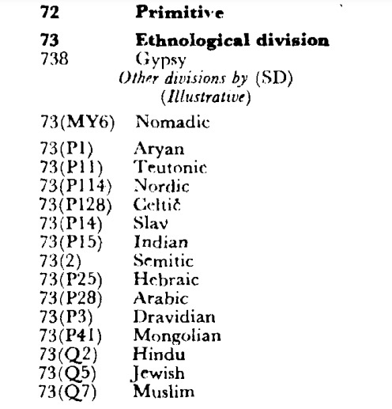
Colon Classification
The notion of ethnic-racial group appears sometimes related to locality, sometimes to religious issues

Slide 10
Integrative Levels Classification - possibilities
tt people
ttU traditional racial grouping
ttU07sly traditional racial groupings, as studied in ethology
ttU07sq traditional racial groupings, as studied in linguistics
ttU07sr traditional racial groupings, as studied in sociology
ttU07su traditional racial groupings, as studied in economics
t95 [qv] communities, speaking language
tt95 [qv] peoples, speaking language
qvUs Spanish
tt95Us peoples, speaking Spanish
tt95Us07sr peoples, speaking Spanish, as studied in sociology

Slide 11
Expected results
We intend to provide a methodological-theoretical framework with aspects needed to represent ethnic-racial knowledge
Among the expected results, we intend to represent in the ILC a set of concepts related to the field of ethnic-racial studies
Facilitating the representation of the connection of different facets related to, for example, the notion of ethnic-racial groups, like some seen so far, related to location, language, characteristics, religion etc.

Slide 12
Obrigada Grazie THANKS
ninabarcellos@id.uff.br
lmcampos@id.uff.br

